Slide 1

Computer Programming for Engineers
Week 4 Lecture 2
Sep. 22, 2022
Lecturer: Mohammad Mahdi Javidan
College of Engineering, Sungkyunkwan University
Fall Semester 2022

Slide 2

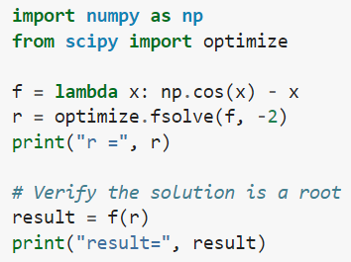

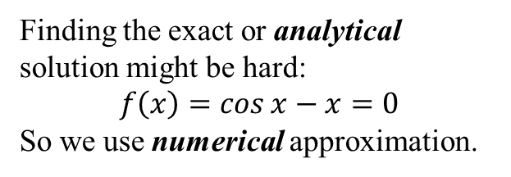
Root Finding
Finding the exact or analytical solution might be hard:
$$f\left(x\right)=\cos{x}−x=0$$
So we use numerical approximation.
Find a root near -2
College of Engineering, Sungkyunkwan University

Slide 3


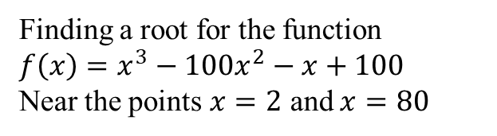
Root Finding
Finding a root for the function
$f\left(x\right)=x^{3}−100x^{2}−x+100$
Near the points $x=2$ and $x=80$
College of Engineering, Sungkyunkwan University

Slide 4
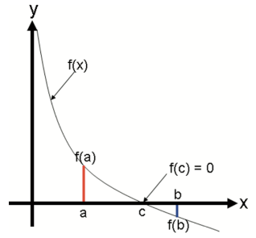
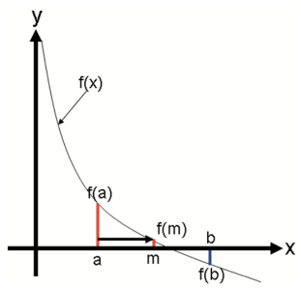


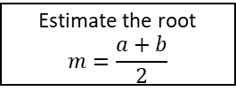




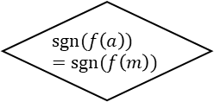
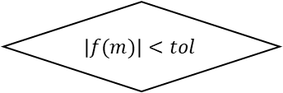
Bisection Method
Start
Guess $a$ and $b$ so that $\operatorname{sgn}{f\left(a\right)≠\operatorname{sgn}{f(b)}}$
Estimate the root
$$m=\frac{a+b}{2}$$
$$\left|f(m)\right|<tol$$
No
$$\operatorname{sgn}{(f\left(a\right))}=\operatorname{sgn}{(f\left(m\right))}$$
Yes
$$a=m$$
Yes
No
$$b=m$$
Root equals $m$
End
College of Engineering, Sungkyunkwan University

Slide 5
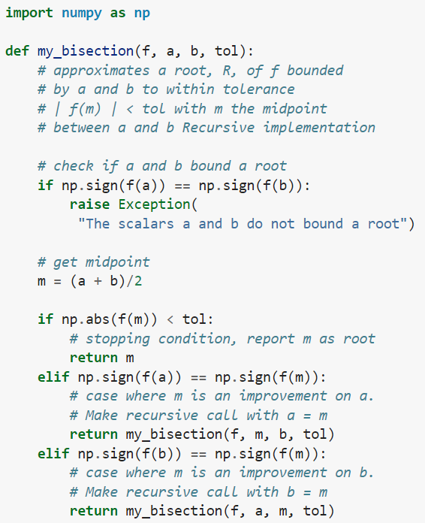
Bisection Method
College of Engineering, Sungkyunkwan University

Slide 6
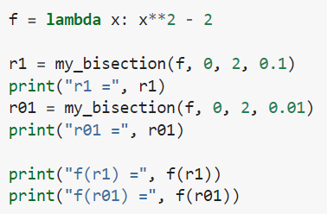
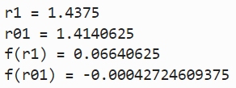
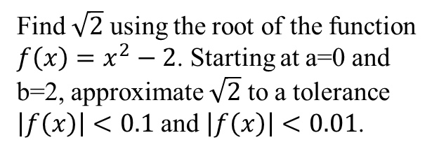
Bisection Method
Find $\sqrt{2}$ using the root of the function $f\left(x\right)=x^{2}−2$. Starting at a=0 and b=2, approximate $\sqrt{2}$ to a tolerance $\left|f\left(x\right)\right|<0.1$ and $\left|f\left(x\right)\right|<0.01$.
College of Engineering, Sungkyunkwan University

Slide 7
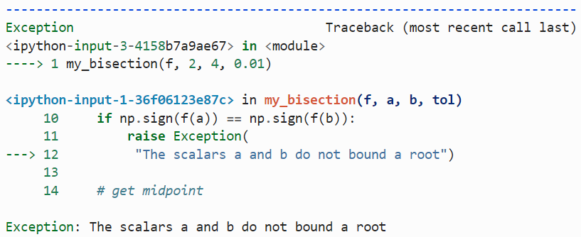
Bisection Method
See what will happen if you use a=2 and b=4 for the my_bisection function
College of Engineering, Sungkyunkwan University

Slide 8





Discussion on Tolerance
Ensures at least n significant figures
College of Engineering, Sungkyunkwan University

Slide 9
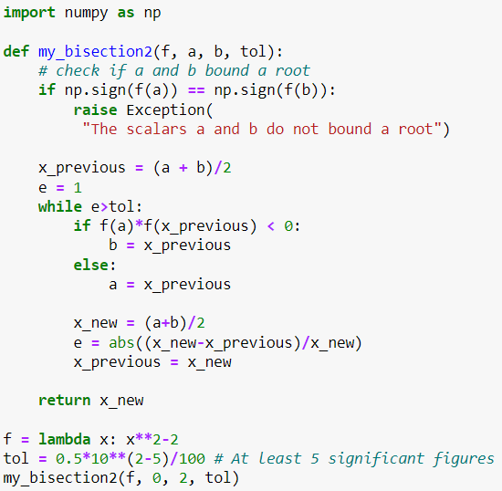
Bisection Method
Calculating the root based on number of significant figures using the iterative function my_bisection2
College of Engineering, Sungkyunkwan University

Slide 10
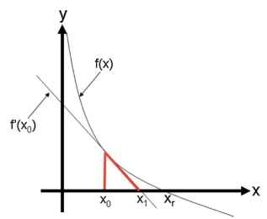



Newton-Raphson Method
College of Engineering, Sungkyunkwan University

Slide 11
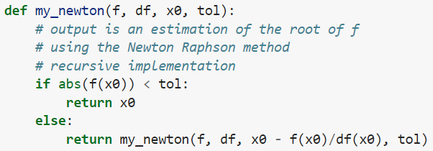



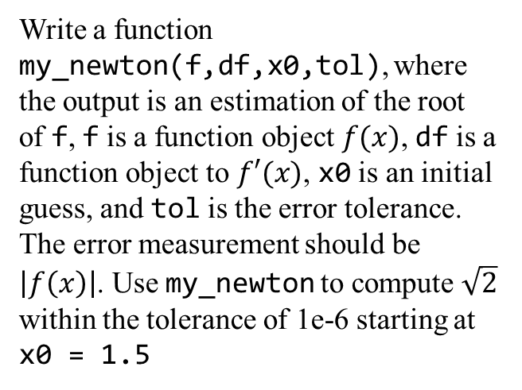
Newton-Raphson Method
Write a function my_newton(f,df,x0,tol), where the output is an estimation of the root of f, f is a function object $f(x)$, df is a function object to $f′(x)$, x0 is an initial guess, and tol is the error tolerance. The error measurement should be $\left|f\left(x\right)\right|$. Use my_newton to compute $\sqrt{2}$ within the tolerance of 1e-6 starting at x0 = 1.5
College of Engineering, Sungkyunkwan University

Slide 12

Modified Newton-Raphson Method
College of Engineering, Sungkyunkwan University

Slide 13
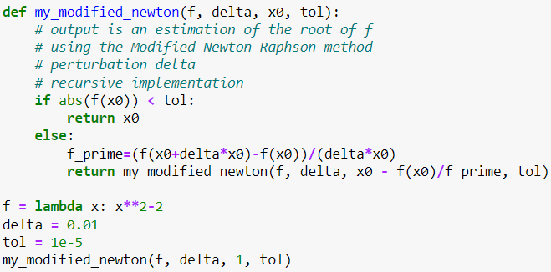
Modified Newton-Raphson Method
College of Engineering, Sungkyunkwan University

Slide 14
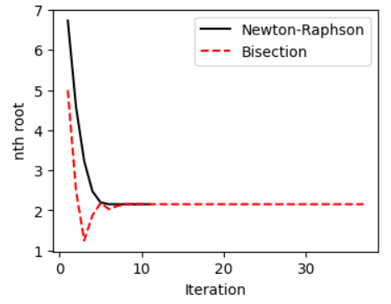
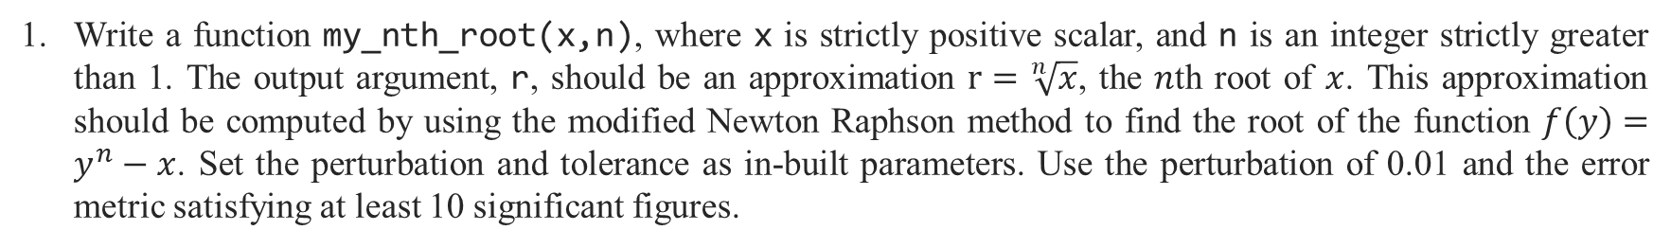
Assignment 6
Write a function my_nth_root(x,n), where x is strictly positive scalar, and n is an integer strictly greater than 1. The output argument, r, should be an approximation $r=\sqrt[n]{x}$, the $n$th root of $x$. This approximation should be computed by using the modified Newton Raphson method to find the root of the function $f\left(y\right)=y^{n}−x$. Set the perturbation and tolerance as in-built parameters. Use the perturbation of 0.01 and the error metric satisfying at least 10 significant figures.
Write the previous function to find the $n$th root using the bisection method. Calculate the 5th root of 700228 using the two functions and draw the estimate at each iteration for both of them in a figure and compare the convergence rate.
Test Case
College of Engineering, Sungkyunkwan University

